Slide 1
Digging Deeper:
A Quick Tour Through
Census FTP Downloads
Steve Barker
Program Manager
State Data Center
Notes:
Hello and good morning. My name is Steve Barker and I’m the Program Manager for the Oklahoma State Data Center, part of the Oklahoma Department of Commerce. I’m a trained Economist by education, and a research analyst by profession. I’m not a librarian, and I’m not from Texas. So, why the heck am I here?
Well, there was a line from the mid/late 1980s that fits here. Back then, a wave of commercials and comedians worked around the line, “I’m not a doctor, but I play one on TV.” So, if you will allow me to stretch reality a bit here, “I’m not a librarian, but I play one on TV.”

Slide 2


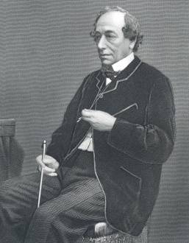
Building the Connection
“I have always imagined that Paradise will be a kind of library.”
  Jorge Luis Borges
“In your thirst for knowledge, be sure not to drown in all the information.”
  Anthony J. D’Angelo
“There are three kinds of lies…”
  Benjamin Disraeli
Notes:
In my job, I help researchers find some nugget of information as it relates to a given project. Most often, I deal with businesses looking to expand or apply for some kind of tax credit, or with community developers filling out some kind of a form like a grant application, or with local citizens wanting to know some tidbit of information about their home town in advance of a Toastmasters speech.
Sometimes the information they seek is easy, like: “What’s the population of my city?” or “How many college graduates live in my area?” Sometimes it gets a bit more involved, like: “What’s the impact of Hispanic owned businesses in the state?” or “Where is the highest concentration of poverty in Oklahoma?” And sometimes they get even more involved, like: “Can I get an electronic file with historical county population growth patterns for the last 40 years for every county in the state, and then be able to compare that growth against every other county in the US?”
Well, depending on where you in the audience sit in the library bureaucratic food chain, I would imagine most of you have fielded questions like this at some point in your careers. So, there is at least a bit of kinship here.

Slide 3
Today’s Agenda
A Brief Overview of Census Data Sources
File Transfer Protocol – the FTP Site
Finding Your Way
  Example - American Community Survey
  Example - 2010 Redistricting Data
Questions (time permitting)
Notes:
Today we’ll be talking briefly about the Census Bureau’s various sources for obtaining data before going into the FTP site itself. We will spend a good chunk of time walking through two examples of FTP downloads, including one from the American Community Survey, and a second from the 2010 redistricting data set. Then, time permitting, I will field questions.
Don’t be too worried about the number of slides I have in this presentation – I intentionally went for overkill here. Most of these are quick screenshots that walk you through the steps in detail. I wanted to make sure that if you try to do this at your desks once you leave this conference, or if you hand it off to someone else who wasn’t here, there would be plenty of material in the slides to keep everyone on track.

Slide 4

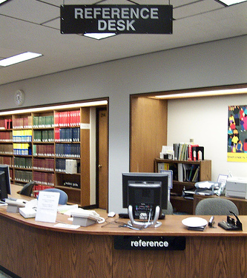

A Brief Overview of Census Data Sources
You
Census Headquarters

Slide 5
Some Leading Census Data Sources
Hard copy, CD/DVD
  Census Bureau has made a conscious decision to slowly move away from these environments
Census Bureau on the web
  Main website www.census.gov
  American FactFinder www.factfinder2.census.gov
  Data Ferrett www.dataferrett.census.gov
  FTP www2.census.gov
Notes:
The Census Bureau likes to say that finding Census data is easy, but really, if it were that easy, then why do you have so many people coming into your libraries and asking questions?
You can find historic information using bound documents or various CD/DVD tools, but the Census Bureau is moving away from these options in favor of more robust web tools like American FactFinder, Data Ferrett, and their FTP site.

Slide 6
Assumptions About FTP
Users have pre-existing expert knowledge of Census products
  If not, you can be here but work with caution
Users are comfortable working with large sets of data
  Many sets have several thousand rows of data
Users have the necessary tools
  SAS or similar statistical software
  Microsoft Office Suite 2007 or equivalent
Notes:
The FTP site is a great tool, but a good word to describe it is “raw”. The Census Bureau assumes that anyone using the site is already an expert data user, familiar with their terminology and comfortable using large sets of data. They also assume that anyone using the FTP site is able to use large database applications like SAS or ORACLE, or that users at least have one of the most current versions of Microsoft Office products or some similar set of applications. These are big assumptions, particularly since the Census Bureau is specifically driving some users to the FTP site, as I will bring up a few slides from now.

Slide 7
FTP Limitations
Text based instructions may be limited and technical
There are very few tutorials
Not everything is clearly labeled
  lots of holdover files from era when names were limited to 8 characters
Hard to walk you through the process in an ‘over the phone’ setting
Notes:
There are some important limitations to FTP – namely, that documentation is not always the easiest to follow. There are few tutorials. And a lot of the older file names are based on the old 8 character limitations. The site is designed assuming you already know virtually all you need to know about the data, and you just need the data itself.
If you don’t know your way around, that makes it really tough to use. Which begs a question -

Slide 8
So Why Use FTP?
Need an electronic file showing population by Census Block in
  Tarrant County, TX
  Orange County, CA
  Oklahoma County, OK
  “Your selection is too large to view this product, please remove some items from ‘My Selections’ and try again.”
Need electronic file with population characteristics from 1980 or 1990 Census
  Can get *.pdf via archives, but exportable results not available via AFF2
Notes:
Why even bother using FTP?
Between 2000 and 2010, the number of Census Tracts in Oklahoma grew to 1,046 and the number of Census Blocks grew to 269,118. That’s a gain of 56 new Census Tracts, not so much, and 93,054 Census Blocks, sounds like a lot.
But Oklahoma’s 2010 total number of Census Tracts, just over 1,000, is roughly equivalent to the number Tracts added in California. Same thing with Florida. And Oklahoma’s total number of just over 269,000 blocks isn’t that much more than the over 239,000 Census Blocks added in Texas. Does anyone want to hand type that in?
If you try to download that amount of information from American FactFinder, you will probably get a message shown here as it would appear on your screen – “Your selection is too large to view this product, please remove some items from ‘My Selections’ and try again.” And yes, that’s a run on sentence so no comments from the English majors out there.
And what if you want population information from the 1980 or 1990 Census? In a relatively short period of time, you can pull hard copy files from your shelves or you can pull *.pdf files from the Publication area of the Census Bureau’s website, but do you have those numbers in an electronic database readable format? Again I ask: “Do you want to hand type all that information?”

Slide 9
Want Another Reason?
Not every ACS table is available on American FactFinder, but they are available in FTP
  7 examples out of 295 such tables
    Means of Transportation to Work by Age
    Sex by Age by Citizenship Status (Hispanic or Latino)
    Place of Birth By Marital Status in the United States
    Grandchildren Under 18 Years Living With A Grandparent Householder By Age Of Child
    Median Age at First Marriage by Race
    Women 15 To 50 Years Who Had A Birth In The Past 12 Months By Marital Status And Poverty Status In The Past 12 Months
    Mortgage Status by Age of Householder
    Full list available at http://www.census.gov/acs/www/data_documentation/2009_5yr_data/
Notes:
And what about the information you can’t find anywhere else?
According to the link at the bottom of this slide, there are 295 tables from the 2005-2009 American Community Survey 5 year data set that are not available in American FactFinder. They are ONLY available via the FTP site. Here are just a few.

Slide 10
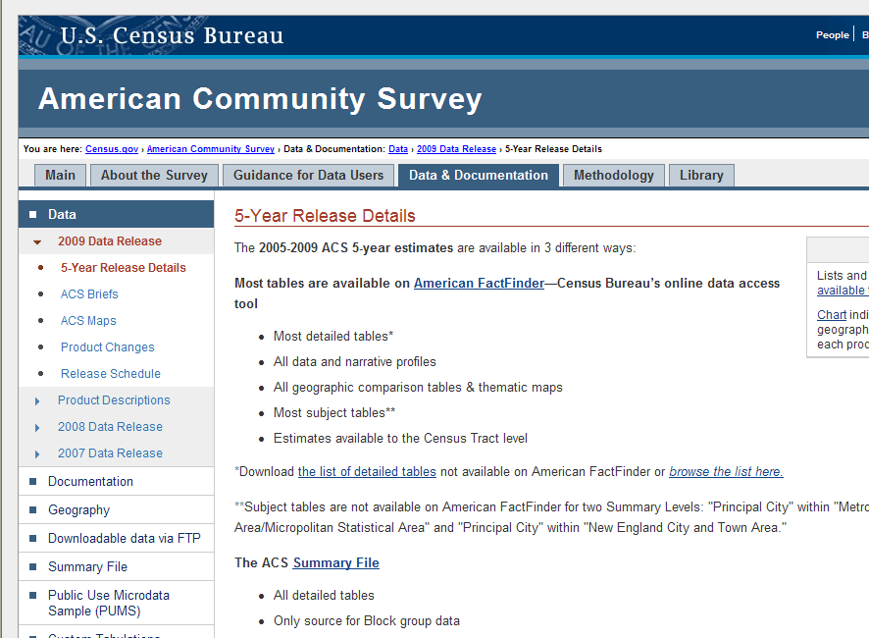
How to Find The List
Using link on previous slide, you get this page
Click ‘list of detailed tables’ to see what’s not on ACS
Notes:
If you pull up that link, you will see this page. The font here is really small, so I circled the important part in red. It reads “Download the list of detailed tables not available in American FactFinder or browse the list here.” Click there and you will see what’s not available.
The point I want to underline here is this – if you want to see these tables, you have no choice – you have to use the FTP tools.

Slide 11
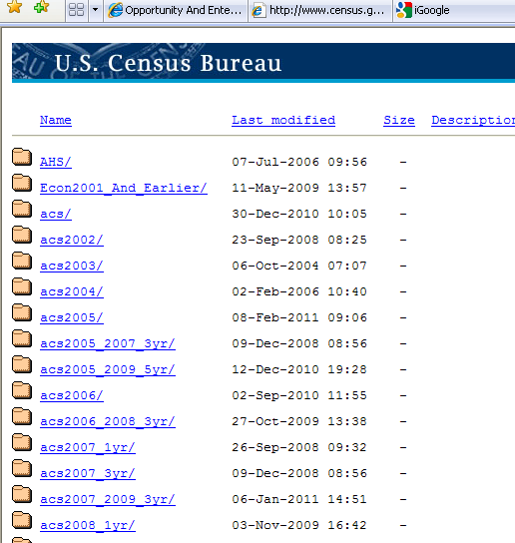
The FTP Site
http://www2.census.gov/
Notes:
Here we have a partial screenshot of the FTP site itself. You can see the actual link to the site at the bottom of the slide.
Notice this is laid out in a simple folder tree format and it operates like any other file list. You scroll through, and double click to choose your options and advance to the next level of the tree.
As I said, this is a partial screenshot. I couldn’t fit the full list of available files on this slide, so…

Slide 12
What’s Out There?
http://www2.census.gov/ Main Folder Options
AHS – Requires SAS | acs2008_1yr | econ2003 | outgoing
Econ2001_And Earlier | acs2008_3yr | econ2004 | plmap
acs | acs2009_1yr | econ2005 | pop
acs2002 | acs2009_3yr | econ2006 | prod2
acs2003 | acs2009_5yr | econ2007 | pub
acs2004 | acs_special_tabs | econ2008 | retail
acs2005 | census_1980 | econ2009 | services
acs2005_2007_3yr | census_1990 | econ2010 | tms_data
acs2005-2009_5yr | census_2000 | geo | video
acs2006 | census_2010 | govs | w3c
acs2006_2008_3yr | ces | hhes | wholesale
acsS2007_1yr | dadso | lehd | USEFUL
acs2007_3yr | econ | lost+found | NOT SO MUCH
acs2007_2009_3yr | econ2002 | manufacturing
Notes:
We have this slide. This is a general rundown of what’s out there as of March 22, 2011.
Anything in black text, I considered to be useful in my own work. Anything in green I didn’t find to be very useful. Maybe it was an empty folder, maybe it duplicated information elsewhere that was easier to get to in that other location. But as you can see there are several areas that I found to have information I considered to be of benefit – the relevant areas relating to either the American Community Survey, the Decennial Census, or the Economic Census.
AHS – American Housing Survey
These require SAS or SPSS software
ACS – American Community Survey data
Lots of Excel files
Very handy
Decennial Census – 1980, 1990, 2000 and 2010
Mostly *.txt files
Very handy
CES – Center for Economic Studies
An inventory of technical and working papers
DADSO – Data Access and Dissemination System Overview
Clips from Census Industry Day
ECON – Economic Census information
Lots of *.dat files (text based - can open with Excel or Wordpad)
GEO – Geography
Map and boundary tables duplicated elsewhere
GOVS – Census of Governments
Text and Excel based files
HHES – Housing and Household Economic Statistics
Not much here
LEHD – Longitudinal Employer Household Dynamics
Not accessible for public
Manufacturing
Nothing there
PLMAP – place map
2000 Census Place Maps by state by county
POP
Nothing there
Prod2
*.pdfs with LOTS of older Census data – appears to be same as what shows up in Publications area
1960, 1970 and 1980 census tables by state, by place, and more
PUB
Outgoing files from Census
RETAIL
Duplicates tables and news releases
SERVICES
Duplicates tables and news releases
TMS_DATA
No clue
VIDEO
Not useful
W3C
Not useful
WHOLESALE
Not useful

Slide 13

Now, Learn Your Way Around That In 45 Minutes or Less
Notes:
In the time I have here today, there is simply no way to cover everything, so I encourage you to spend a little time playing with this on your own. My presentation is geared to show you how I do things. You might find a better way. You might know something about the application tools that I don’t. But if you want to get everything possible out of today’s discussion, you have to spend some time noodling about the FTP site on your own.
Ready? Let’s dive in.

Slide 14

Finding Your Way
An Example Using American Community Survey
Notes:
Finding Your Way – An Example Using American Community Survey.
Is there anyone in the room here today that has not heard of American Community Survey?
Very briefly, it replaces the old long form of the Decennial Census and is now the best source for answering questions about population and household characteristics like income, poverty, disability, veterans status, home mortgage status, and things like that.
I’m not going to spend any time here talking about the ACS itself. If you have questions about that I can talk with you afterwards. Instead I really want to focus on the process for accessing ACS data from the FTP site.

Slide 15
Start With The Documentation
Look for key words in file names
Here are some hints (not exhaustive list):
  Methodology
  README
  Note
  Datadict (data dictionary)
  Help_guide
  TableShells
  TechDoc
Notes:
First, I present you with a sort of cribsheet on what to look for in the way of documentation – You should almost always start by opening and skimming through files with names that contain words like methodology, readme, helpguide, etc. That’s how you find out all kinds of useful information providing guidance on how to read the data, how to translate numeric or alpha numeric codes. Sometimes, rarely, there are some pretty informative tutorials, as is the case with the Economic Census folders.
These documents aren’t always very good tour guides on your trip through FTP land. But they beat being mugged when you don’t speak the language at all.

Slide 16
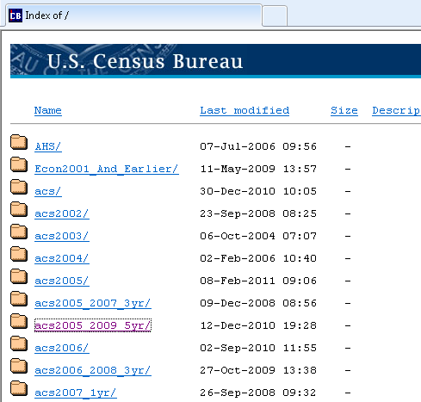
Pick a Data Set From FTP Site
Let’s look at the American Community Survey 2005-2009 5 year dataset
Notes:
Here is the FTP site as we saw in an earlier slide. I’m clicking on the folder that houses data from the American Community Survey’s 2005-2009 5 year data set, circled here in red.

Slide 17
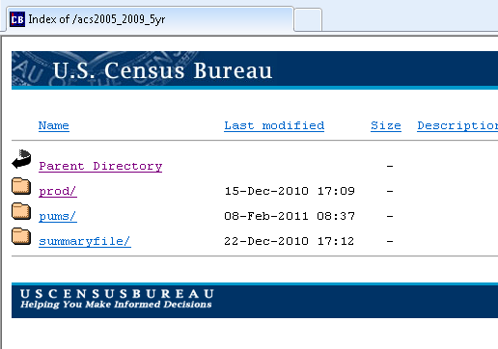
Let the Digging Commence
Click on prod/
Notes:
One click in and you see three folder choices. The files seen here are NOT representative of the subfiles you would see if you clicked into something else, say one of the Economic Census folders, or one of the Decennial Census folders. That’s another strike against the FTP site. The folder formatting isn’t consistent. But consider this:
The structure for the FTP site has been created by representatives from multiple branches of the Census Bureau. How closely do the file trees on your personal computer match up with the trees created by someone in another area of your organization?
I want to look at the various products from the ACS, so I’m going to click on the ‘prod’ folder.

Slide 18
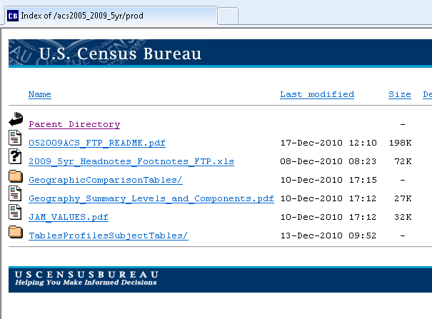
Our First Nuggets
You see several options for guidance
We start here with the README document
Notes:
Here you see several of those ‘key word’ clues I mentioned a few slides ago. You see README circled in red, followed by Headnotes_Footnotes , and some *.pdf files a little further down. Lets look at the first one listed – the README file.

Slide 19
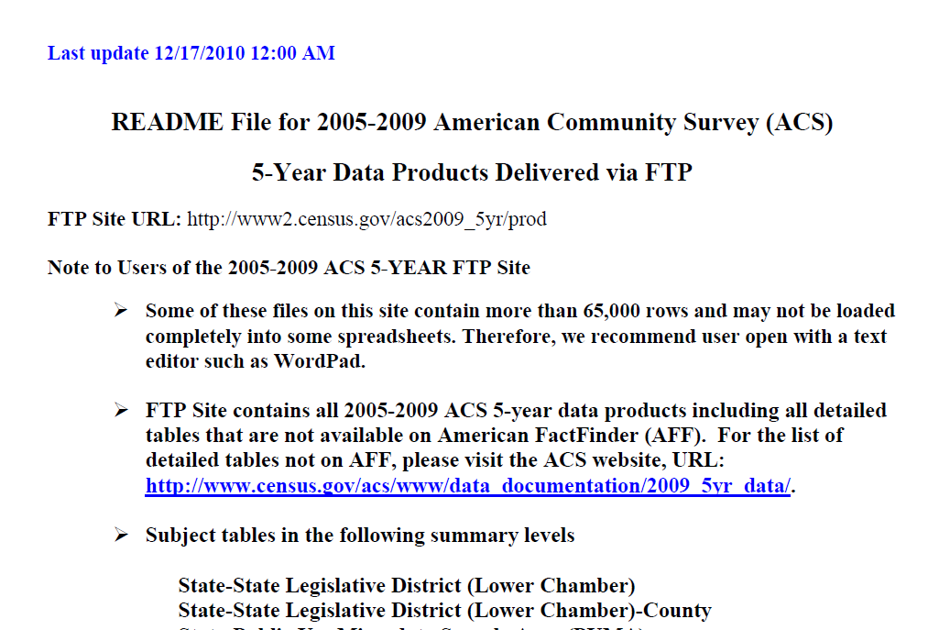
What The File Says
You find notes that help you understand what’s included
Notes:
The file itself isn’t particularly long with only 9 pages, but it does contain some very helpful information.
By the way:
Just as would be the case in many organizations, there are some of you who don’t want to become content experts. You may see your job responsibilities as finding the data, handing it off to your customers, and letting them sort it out on their own.
The way the FTP site works, you can’t really do that. Because of the lack of uniformity, the generally lacking condition of documentation, and the common use of shorthand or database codes, you have to look in these files and read the supplemental information.
Without it, you will have a much more difficult time drilling down to the data requested, and if you can get there, you may not know what you are looking at when you get there.

Slide 20
Another Nugget
Now we open the file marked with “notes” in the title
Notes:
Let’s look at another file – the Headnotes and Footnotes file.

Slide 21
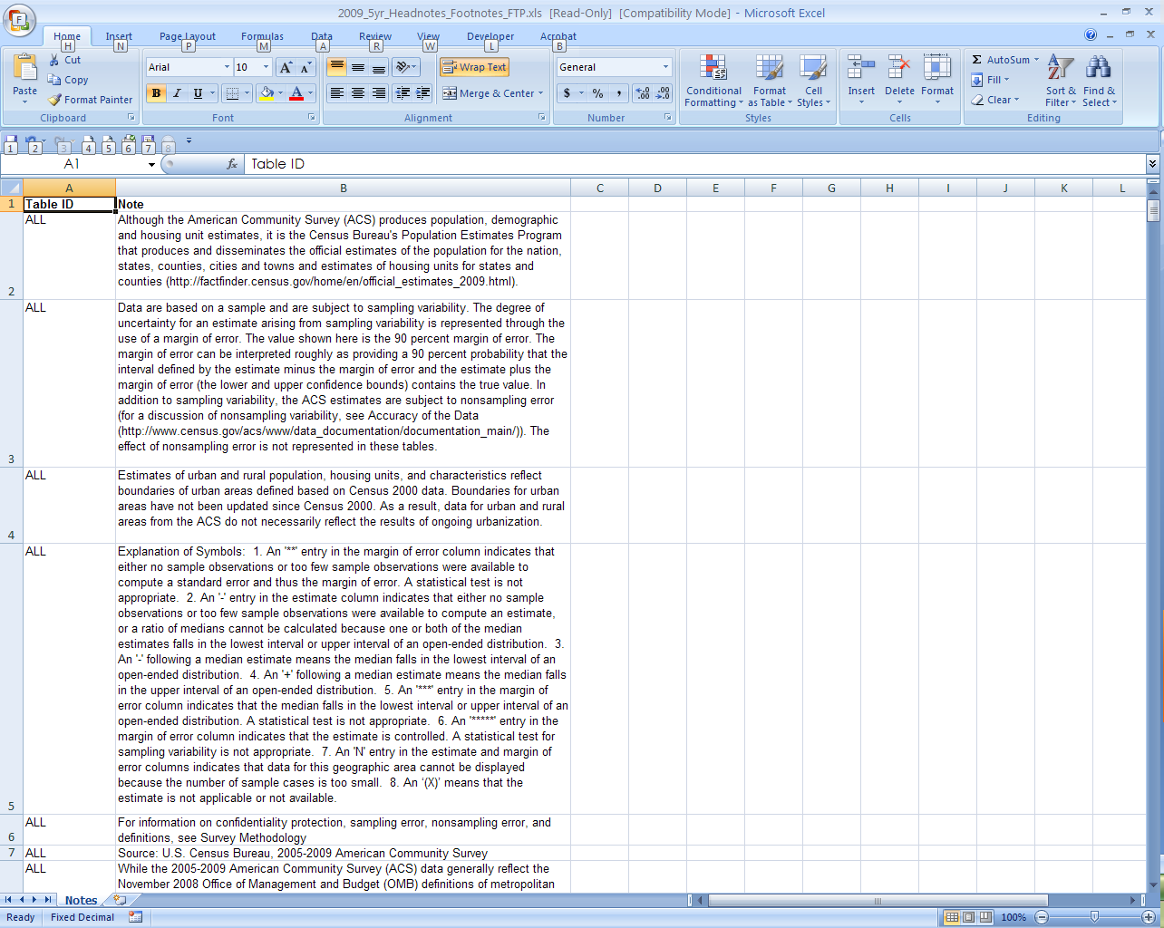
Tips For More Information
Here you find web addresses for further explanation
Notes:
Here you see an Excel file which has almost 500 separate rows of table notes. Many of these are trivial, but many of these also include weblinks to additional information.
The FTP site assumes that users are already experts in using or understanding Census data, but it seems they are also realizing that more people outside the Census Bureau are being pushed to the FTP site to find specific data or bulk data that requires more understanding. They are trying to put more documents like these on the site so non-Census people can better understand what’s going on.

Slide 22
And Another Nugget
Sometimes you need to key off of the *.pdf extension
Notes:
Here we click through to the summary levels file, keying off of the *.pdf marker.

Slide 23
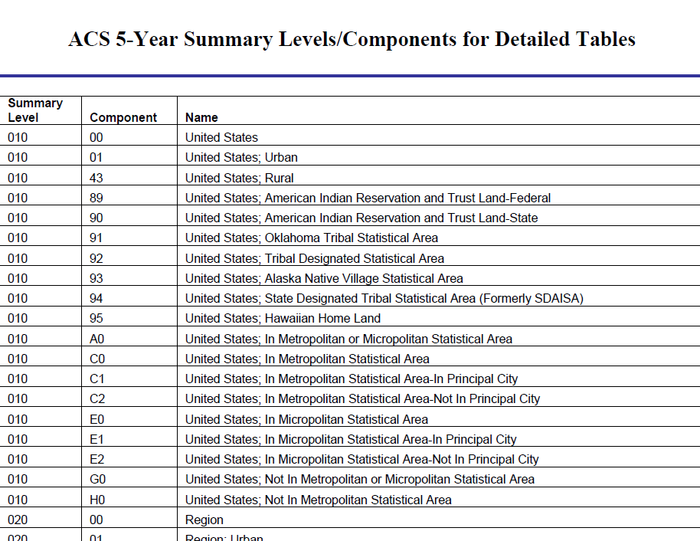
A Key for Translating Data Tables
Notes:
And here you find a key for translating codes that might be used in some of the actual data tables. Notice the first red circle shows the link between Component and Name. Notice the second red circle at the bottom of the page shows a change in summary level and name but repeats the component number.

Slide 24
And Still More Nuggets To Review
Again, look for clues
Notes:
And finally the last *.pdf file.

Slide 25
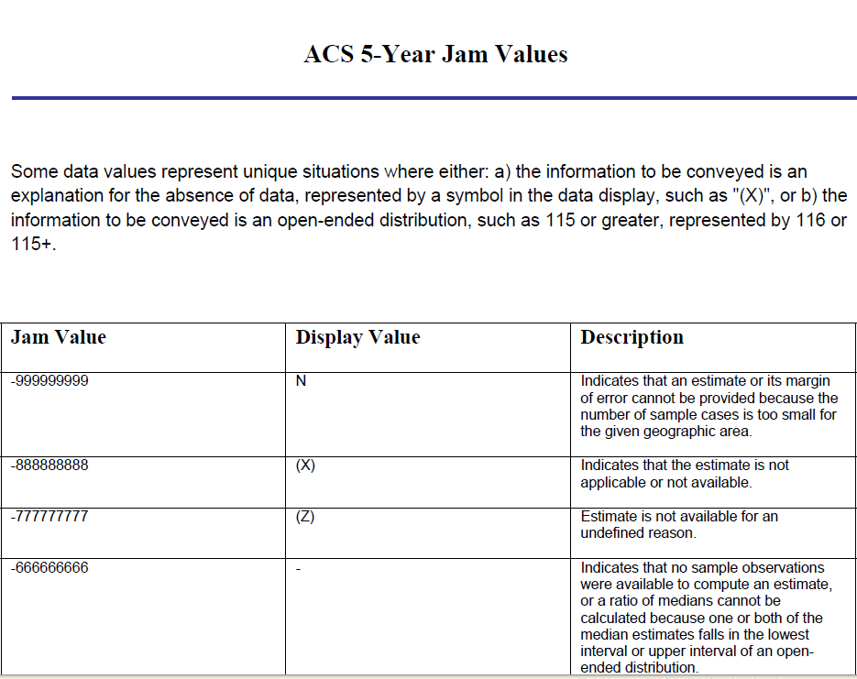
A Key to Translate Values
Here you find value notes to explain certain table values
Notes:
Here you see another key that translates values in a table so you can get some additional guidance where necessary.
I’m not spending much time on these slides here because I’m not focusing on what they say specifically. Instead I’m showing you generally what kind of information can be found there.

Slide 26
Finally, Time To Dig Deeper
Now let’s drill deeper
Notes:
Finally, time to dig deeper in the tree to get closer to the data. I’m clicking on the Tables/Profiles/SubjectTables folder in this slide.

Slide 27
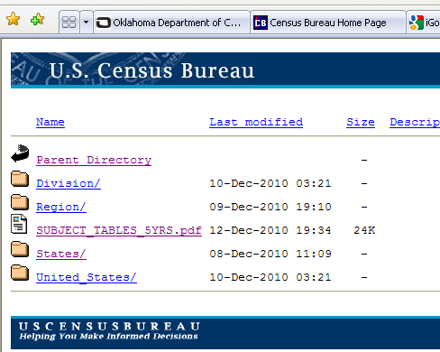
Look! More To Review
And we have another *.pdf to examine
Notes:
Hey, there’s another documentation file! Again, keying off of the *.pdf label.
This shows you that documentation can be found at any level in the FTP tree. Keep your eyes open and you can find some useful stuff this way.

Slide 28
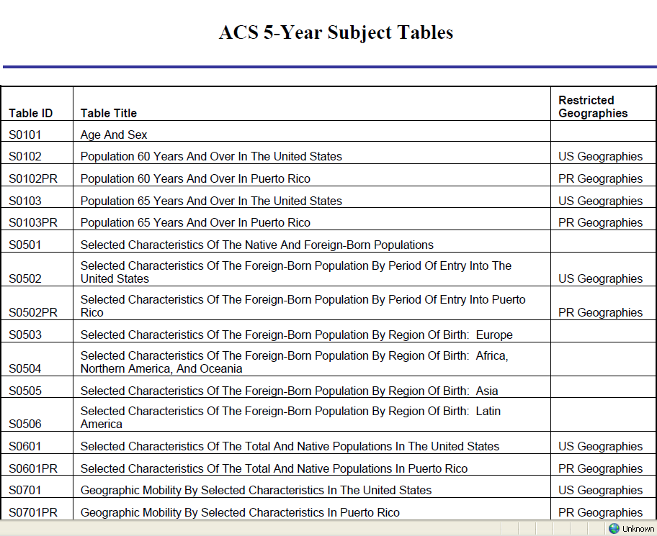
Another Key For Translating Tables
Translating table ID numbers into specific table names
Notes:
Open the file and here you see another table key – this time linking Table ID numbers with the appropriate Table Title.

Slide 29
Digging Again
Now we dig still deeper
Notes:
Digging again – I want to drop to the state level so I click on the States folder. I could just as easily clicked on the United States to get information at the national level.

Slide 30
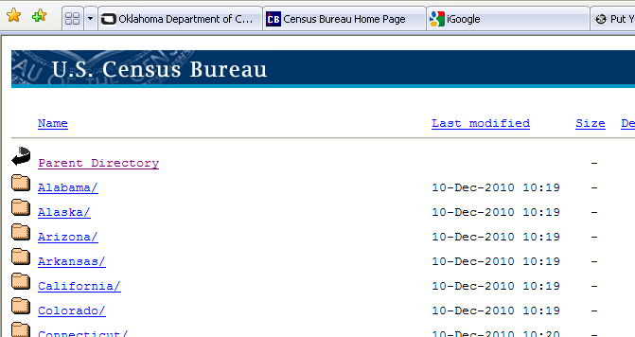
Find Your State
And we dig deeper yet again
Notes:
Here you can scroll down to the state of your choice. I’m using California for two reasons – one, because it’s near the top of the list and easy to show on the screen, and two because it has a large population so will have larger files to work with.

Slide 31
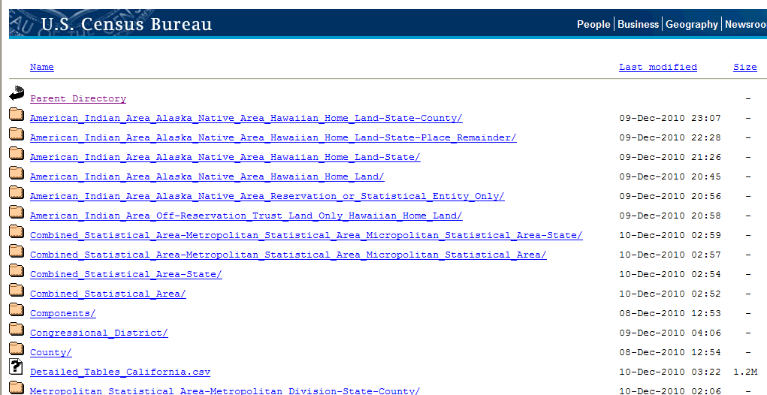
At Last – DATA!
And as we see lower geography options, we can get statewide data or dig still deeper
Notes:
Here you see folders for all the available geographic categories represented in California. This would be very similar regardless of which state you chose. There are many more if you scrolled down the screen.
The actual data files in the ACS data set are all contained in *.csv files. If you dropped into any of these various subfolders, you would see more *.csv folders based on the options chosen.
I want to see information for California as a whole, so I’m choosing the Detailed Tables California.csv file.

Slide 32
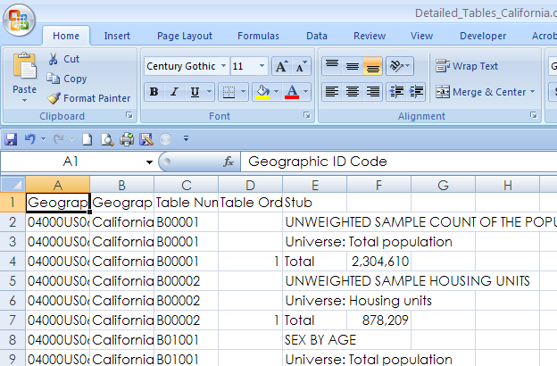
Sixteen Thousand Rows of Data
Notice splits based on table numbers
You can convert table numbers to table names by going to list at
http://www.census.gov/acs/www/Downloads/data_documentation/2009_release/Tables2005_2009_5Year.xls
Notes:
You can open *.csv files using Excel, which I have done here. This file shows the first few lines from 797 tables available in the Detailed Tables file we just opened up.
Column C shows the Table Number, which you can translate to an actual table name by following the link at the bottom of the slide.
This is a great example of how the FTP file gives you the data, but you have to translate some of the codes on your own in order to know what you are looking at. Then you can use Excel to quickly filter the rows so you see just the information you really need.
Here’s how you do it:

Slide 33
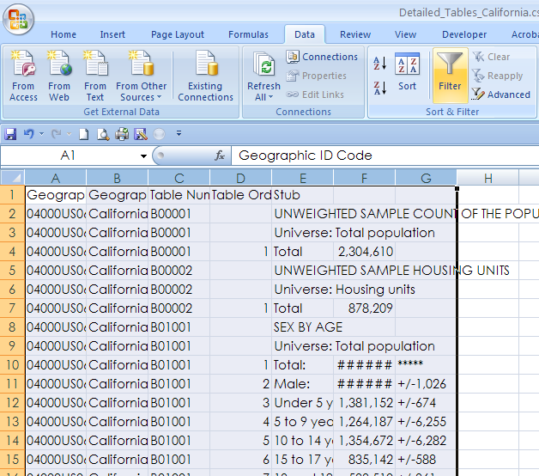
Filter to the Table You Want
Highlight filled columns on the page
Click ‘Data’ at the top of the page
Click ‘Filter’
Notes:
Highlight all the occupied columns by placing your mouse cursor over the left most column, then left clicking (hold the mouse button down) and dragging the mouse to the right over all the relevant columns. Once you have done that, you can let go of the left mouse button. The columns should be highlighted as shown here on the screen.
Click on ‘Data’ at the top of the screen, circled here in red, then click on the ‘Filter’ option, also circled here in red.

Slide 34
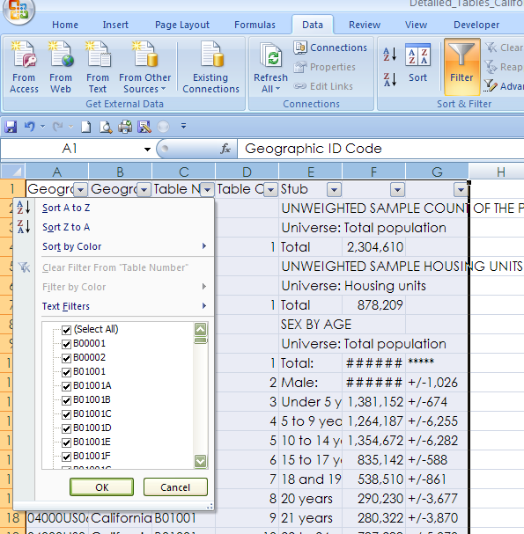
Filter Part Two
Click on the down arrow at the top of the ‘Table Num’ column
Use the filter options
Notes:
After you have done that, you should see small squares at the top of each column. We want to filter on the Table Number, so click on the square at the top of the Table Number column. The square here is circled in red. A series of filter options shows up – chose the table number you want and ….

Slide 35
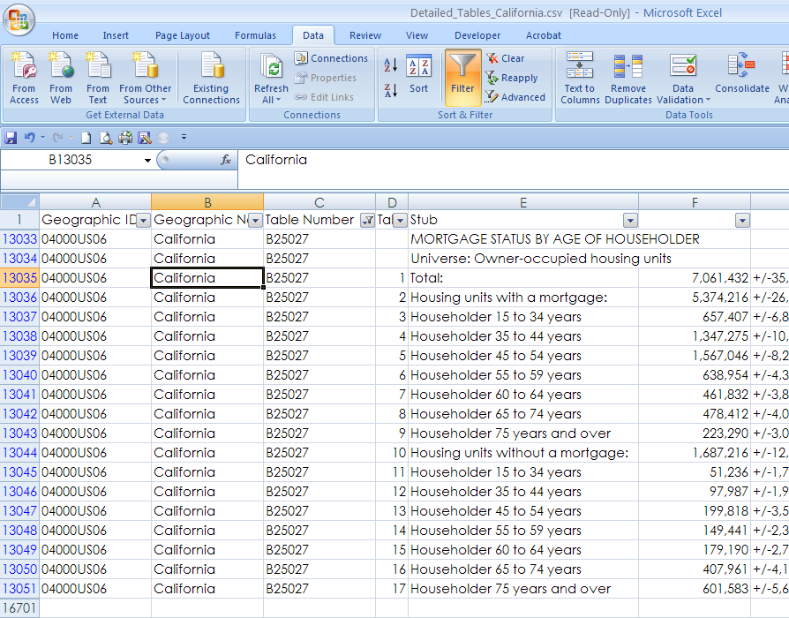
How To See Just The Table You Want
This is one of the tables not in ACS
Note the ‘Filter’ symbol at top of column
Notes:
Now you see only the rows of data available for that specific table number.
Easy as cake right?

Slide 36

Finding Your Way
An Example Using 2010 Census Redistricting Data
Notes:
Another example, this time using 2010 Redistricting data.

Slide 37
Notes About Redistricting FTP
Census assumes you either have SAS or Access in order to view this data
Its up to you to figure out how to view this data if you don’t have those specific tools
Plan ahead!
  It took the better part of a morning to download necessary files, import into Access, and begin working with the data
  That was using a high speed internet connection
Notes:
Let me first say that the process here is somewhat more complicated than the ACS example. The files here are huge, containing several rows and columns, making for a very large data set. The Census Bureau assumes if you are digging through the FTP site to get these files then you have the ability and knowledge necessary to use either SAS or Microsoft Access in order to view the data.
Plan ahead – these steps take a long time to complete and will tie up your computer, particularly if you are using a computer with a slow internet channel.

Slide 38
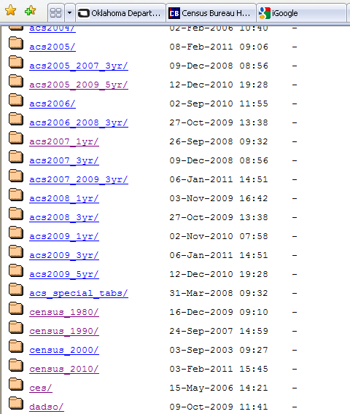
Pick a Data Set From FTP Site
Let’s look at the Census 2010 dataset
Notes:
Pick a data set from the FTP main site. This time I’m choosing the Census 2010 folder, circled in red.

Slide 39
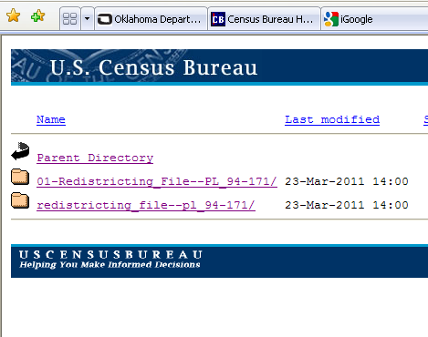
Pick a Data Set From FTP Site
Choose redistricting data set (top option)
Not sure why they have two folders here
Notes:
Here you see two folder options. As far as I can tell, these are duplicates. I’m not sure why they have the files repeated, but for some reason they do.

Slide 40
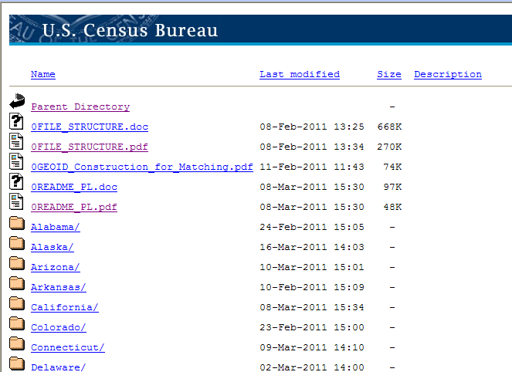
Finding the Support Documents
Notice clues for helping navigate the tables
  File_Structure
  README
  Matching
Notes:
Again, look for clues on the supporting documentation. File_Structure, *.pdf files, or README files.

Slide 41
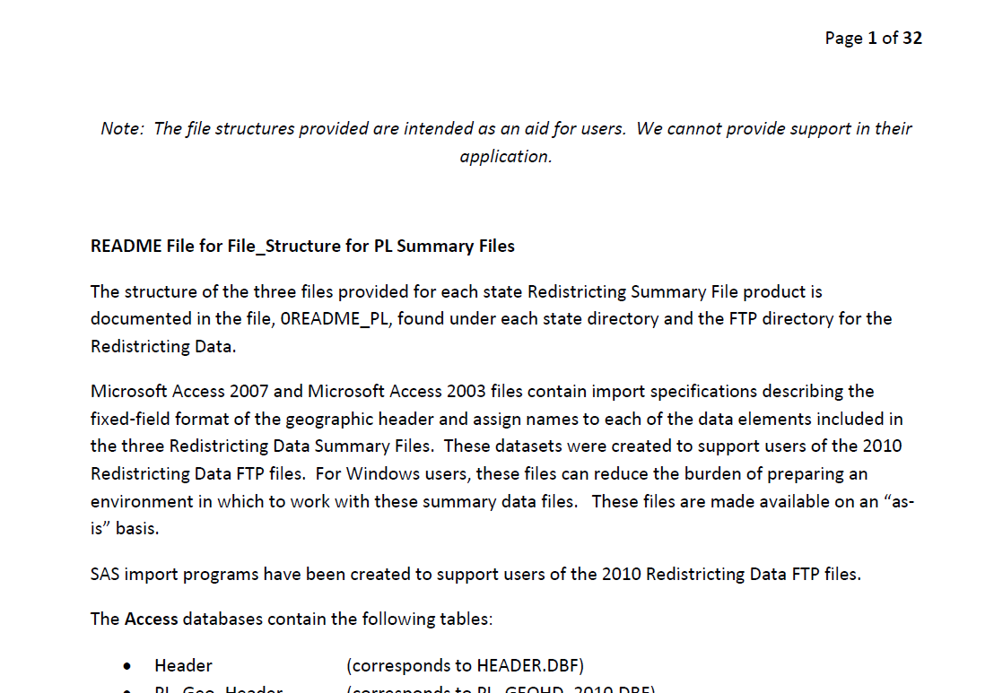
From the FILE_STRUCTURE file
The next slides are based on process for opening data in Access
You can read more detail in the FILE_STRUCTURE document
Notes:
Here you see information from the FILE_STRUCTURE file. This file gives instructions on how to pull the redistricting data into SAS or Access – handy stuff to have at your fingertips. I’m not going to walk you through that process today because we simply don’t have time to do it.

Slide 42
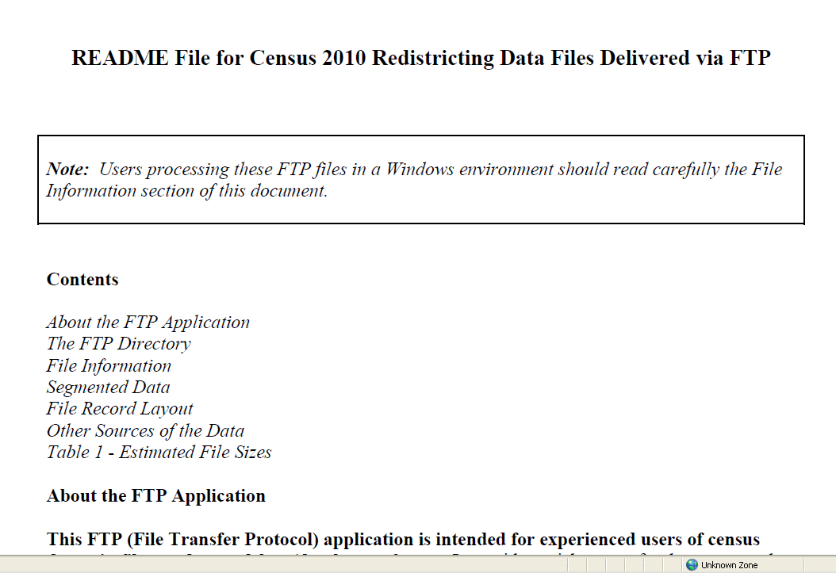
From the README file
Additional tips available with the README file
Notes:
This shows the information available in the README file, including the notation at the top of the page referring readers to the File Information section of the document.
In the slides that follow, I have NOT addressed any of those notes. I am only walking you through the process for opening the files. Therefore, if you plan to use the redistricting data from the FTP site, I recommend you consult these files on your own.
Read them with a tall bottle of the beverage of your choice. I had a college professor who said he found his understanding of technical jargon improved as he got closer to the bottom of the bottle.

Slide 43
Finding the Access Tools
Scroll down the list of states
Find the Microsoft Access application files
Notes:
Now then, here we are, back at the FTP site, inside the redistricting data file folder. Instructions taken from the FILE_STRUCTURE file indicated we could pull files into Access by using pre-constructed models, so I’m going to scroll down the list until I find those models.

Slide 44
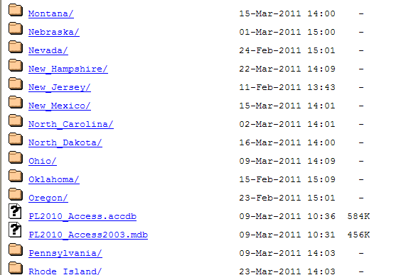
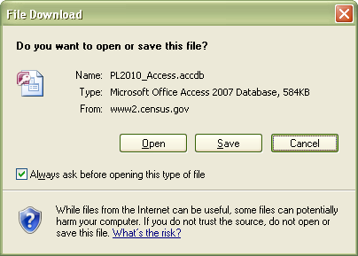
Setting Up
Click on each Access database file and save to your computer
Notes:
The files referred to are circled here in red. Click on those and the “File Download” box pops up. Save those files somewhere on your computer and remember that location.
Once both files are saved, scroll around and find the state you want to examine.

Slide 45
Searching for Data
Pick your state
Notes:
Once again, I chose California as my state to review.

Slide 46
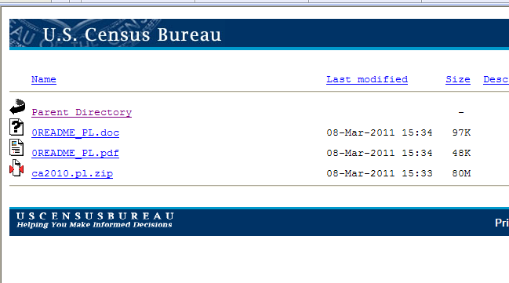
Digging Deeper
Data is contained in the *.zip file
Notes:
Notice that the README file is here again. Trust me that, in this case, it turns out to be a duplicate of the README file we just looked at one level up so I’m not going to walk you through it again.
I’m going to click on the *.zip file. That file contains all of the information I need, only being in a zip file, it’s neatly compacted so it takes up less space.

Slide 47
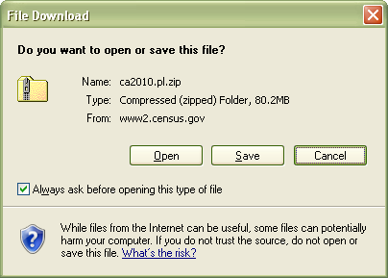
Opening the Data
Save the file so you can work with it
Notes:
After clicking on the file, the ‘File Download’ box comes up again, like it did a few slides ago. Click on Save and put the data somewhere on your computer.

Slide 48
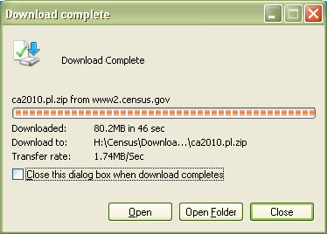
Opening the Data
Open Folder
Notes:
Once the file is saved, click on the Open Folder button so you can move to the next step.

Slide 49
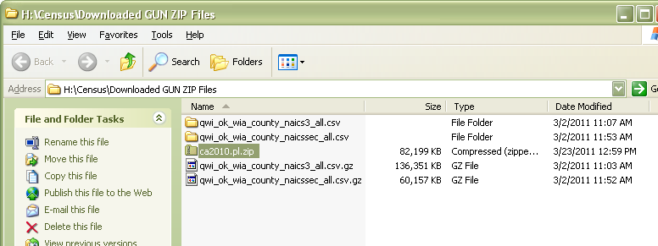
Opening the Data
This will appear different on your computer, depending on where you saved the file
Notes:
Here is where I happened to save the data. Your screen and file choices will differ slightly depending on where you saved your downloaded files. The important thing is this – the name will end in *.zip. That’s the file you are looking for.

Slide 50
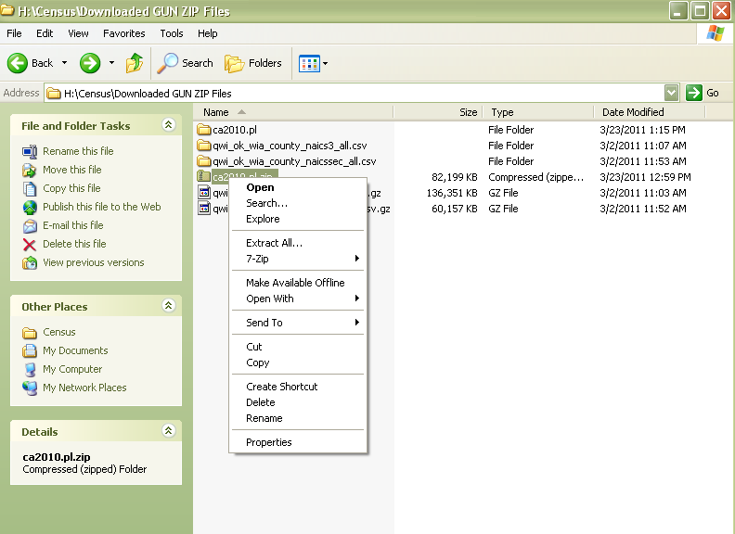
Opening the Data
Right click on the file and choose ‘Extract All…’
Notes:
If you aren’t technically inclined, think of a zip file as one of those space saver bags they advertise on TV.
You put all your stuff into it, suck out all the air, and you can store all your sweaters (or in this case data) away in a smaller space. When you want to use the data, you just need to open the bag and pull it out, ready and waiting.
To do that, you click your right mouse button and choose the ‘Extract All…” choice, highlighted here in red.

Slide 51
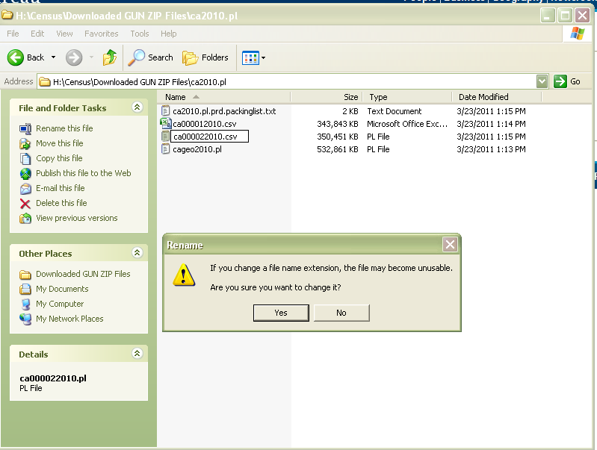
Opening the Data
After extracting, change file extensions from *.pl to *.csv
Notes:
The files will be extracted into a new location, defaulting to a new subfolder inside the one you are working with. Open that folder and you see the newly extracted files, three of which have a *.pl extension. Change that extension from *.pl to *.csv. Here I’ve changed the first one, I’m changing the 2nd one, and will soon change the 3rd one.

Slide 52
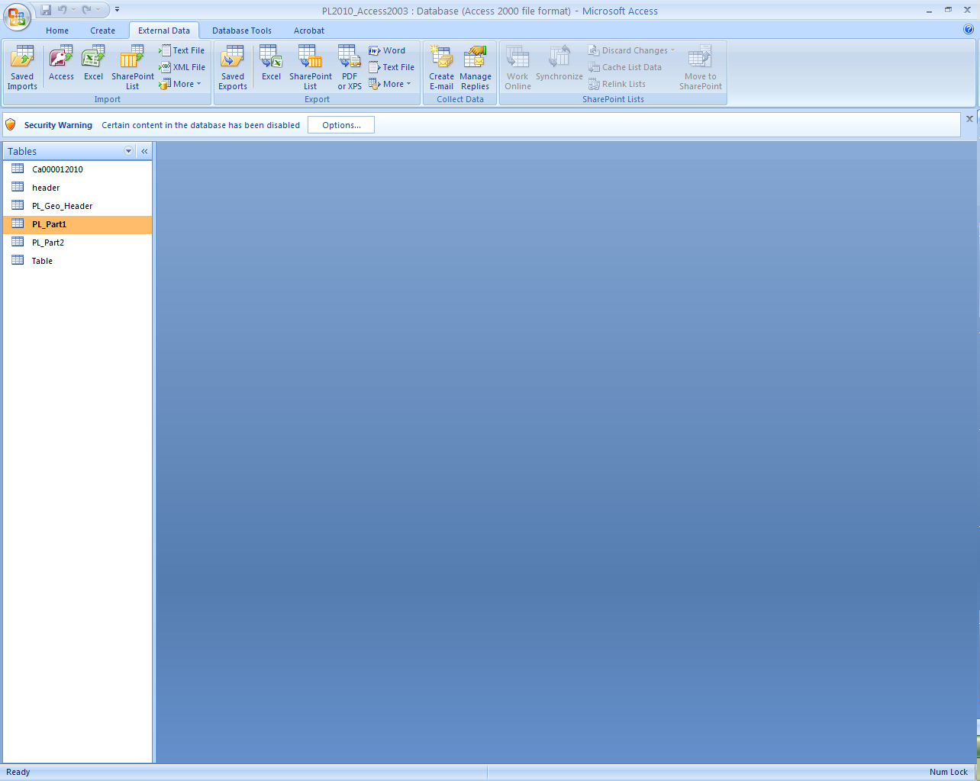
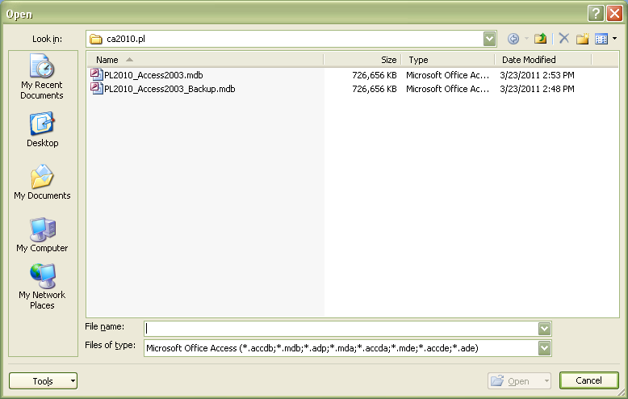
Opening the Data
Using Microsoft Access, open the *.mdb file that you downloaded from the FTP site
Notes:
The next several slides detail how to open the files you have downloaded, using Access, and then you can export the data to Excel if you prefer. I’m not going to go into to much detail on how to work with the data in either environment because my goal today in the time we have is to get you up to that point where you can begin to play with the data on your own.
Remember the FILE_STRUCTURE file referred to in slide 41? That one has instructions on how to finish converting this file for use in Microsoft Access. Or, after converting these files into *.csv files like you did on slide 51, you can open the data directly into Excel.
Much like the Census Bureau, I’m assuming you already have some technical skills with Access or Excel. I’m also relying on you to review the available documentation files we’ve discussed – the README documents, the Notes files, the *.pdf documents.
Unfortunately, within the FTP environment, the Census Bureau relies on us to be self informed. And due to the complexity of many of these data sets, I have to do the same today.

Slide 53

Steve Barker
State Data Center Program Manager
steven_barker@okcommerce.gov
(405) 815-5182
Notes:
Besides, by now I’ve probably turned your brains to mush. Any questions?

